Slide 1

Business Strategy Report
RAPIDO
Mini Project 1

Slide 2


ABOUT RAPIDO
Rapido’s mission - Make daily urban travel affordable, accessible, and convenient while empowering captains with flexible earning opportunities
Founded 2015, Bengaluru - is India’s leading bike-taxi platform for fast and affordable short-distance travel, Best for daily commute and traffic routes
Low-cost, quick bike rides that beat traffic and are cheaper than Ola/Uber cabs
Present in 100+ cities with 1.5M+ captains and ~₹497 crore revenue in FY23
Operates an app-based aggregator model connecting riders with bike/auto/cab owners. Earlier - earned commission per ride, Now - follows Saas model
Notes:
Task 1: Company Introduction
Provide an overview of the selected startup (history, founders, headquarters)
Explain which domain it belongs to and why it is growing
Describe products/services offered and its target customer segment

Slide 3
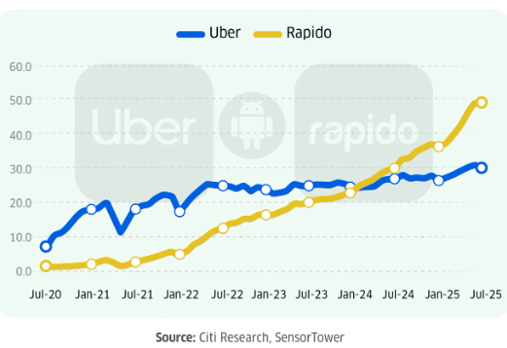
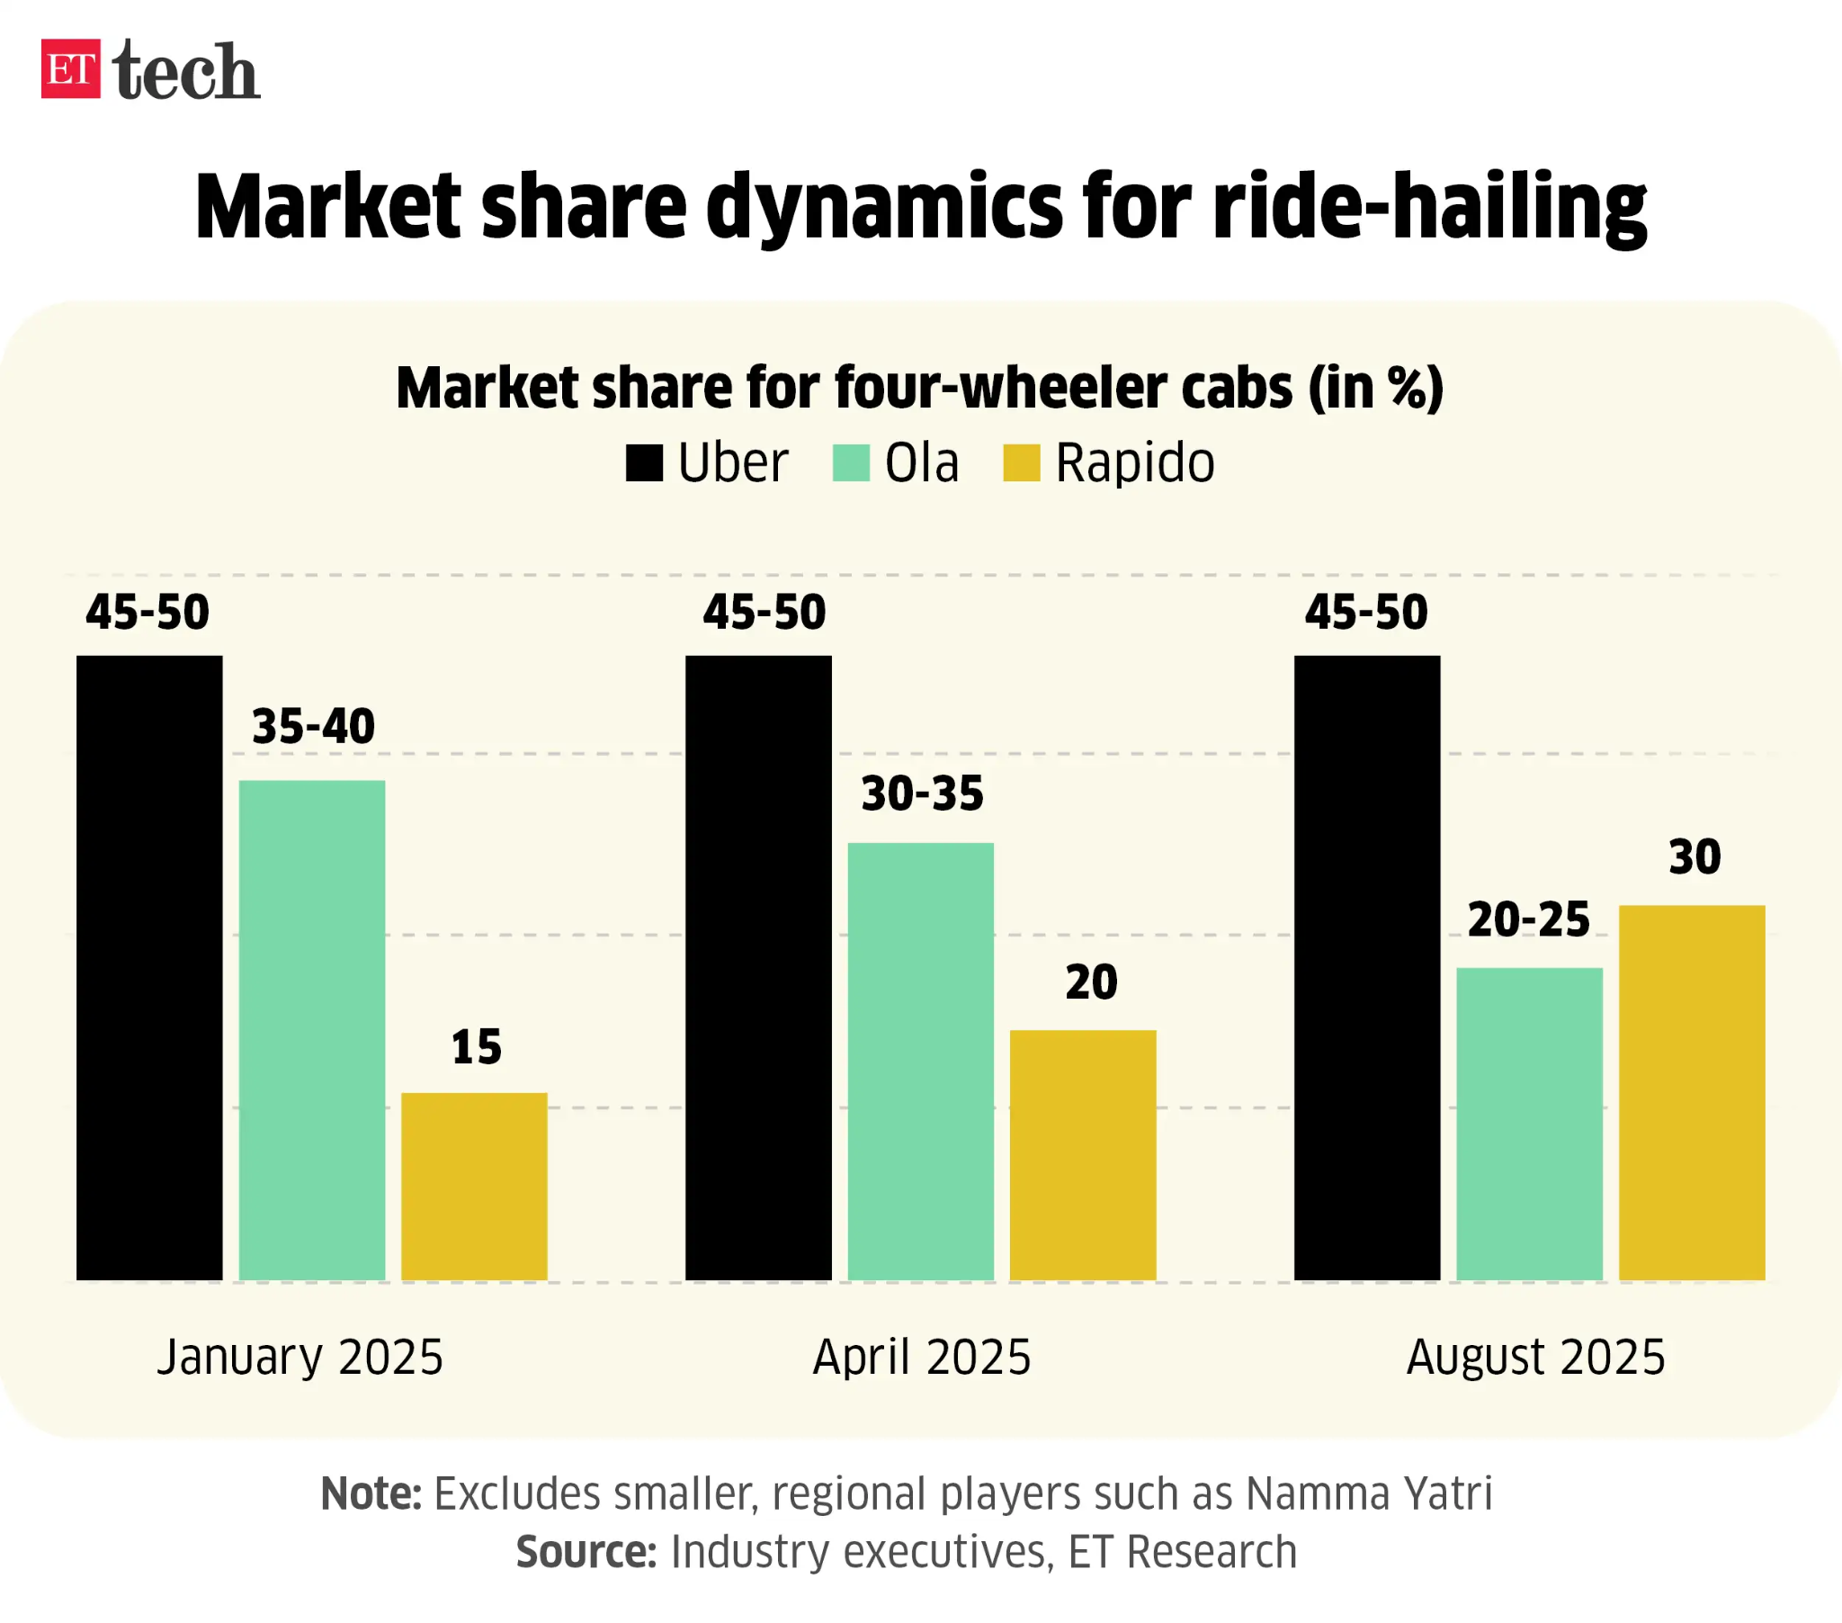
Market position and Growth
Rapido’s growth in order volume and Gross Order Value (GOV) has been very steep: in FY25, GOV reportedly hit US $1.25 billion (≈ 2.5× growth vs prior year).
In FY24, Rapido’s reported ride orders grew ~1.5× compared to FY23 — signaling rapid adoption
Notes:
Task 2: Business Model Analysis
Explain how the company earns revenue
Identify major cost drivers (operations, marketing, etc.)
Describe how the business delivers value to customers

Slide 4

Business Model Analysis
Major Cost Drivers
Operations (captain onboarding, support, platform upkeep)
Marketing (discounts, referrals, ads)
Technology (app development, servers, integrations)
Administrative & Compliance (salaries, legal, regulatory)
Expansion & Delivery Network Costs
Revenue Streams
Captain Subscriptions (daily platform fee)
Ride Commissions (in select segments)
Delivery/Logistics Fees
In-App Ads & Brand Partnerships
Corporate Mobility & Rider Plans

Slide 5
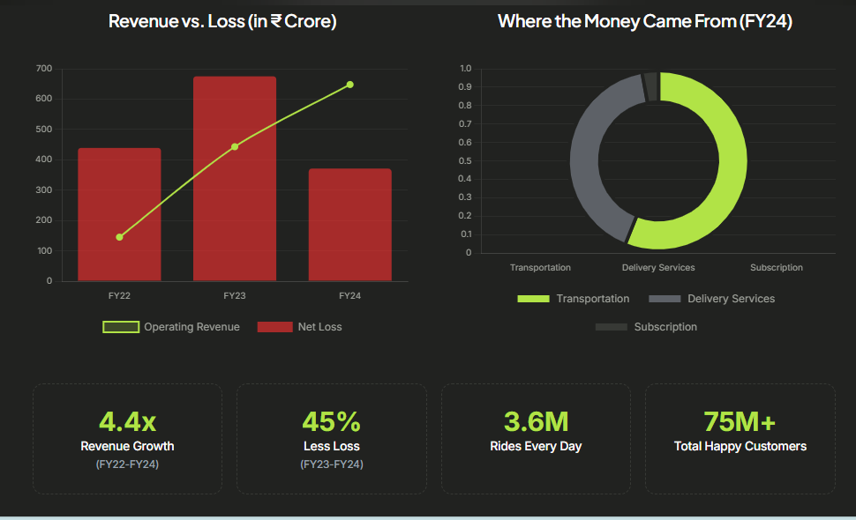
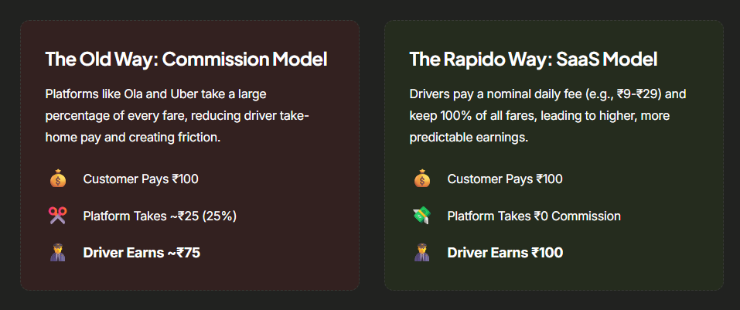
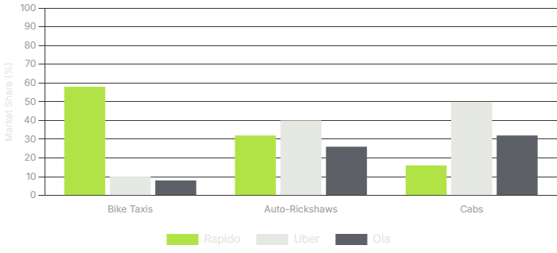
The Mobility Battlefield
This driver-centric model has enabled Rapido to aggressively capture market share from the long-standing Ola-Uber duopoly across all major vehicle segments.

Slide 6
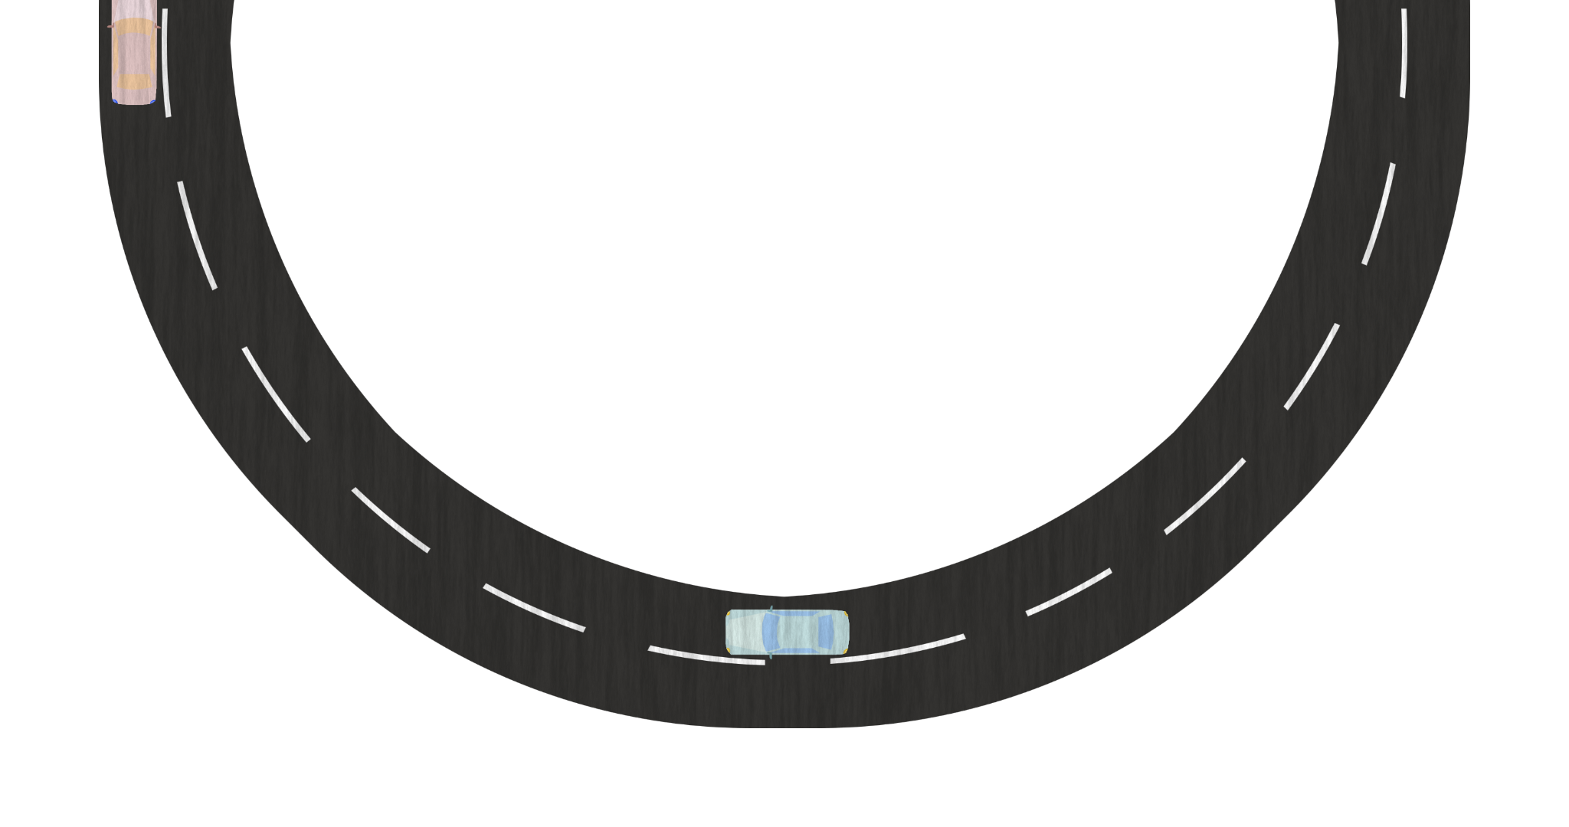
DELIVERING
CUSTOMER VALUE
Faster Travel
Two-wheelers avoid traffic, reducing travel time.
Low Fares
Cheaper than autos/cabs, ideal for daily commute.
Safe & Verified Captains
Background checks, SOS, real-time tracking
Convenient App Experience – Simple UI, live tracking, digital payments.
Reliable & Transparent Pricing
No bargaining; fixed online fare.
High Availability
Large captain network ensures quick booking.
Notes:
Task 2: Business Model Analysis
Explain how the company earns revenue
Identify major cost drivers (operations, marketing, etc.)
Describe how the business delivers value to customers – Top Strengths

Slide 7
01
Strong identity as India’s No.1 bike-taxi brand, instantly recognized by its yellow branding.
Fast, simple, no-confusion app experience designed for quick one-tap bookings.
02
03
04
Brand message: “Smart, fast and affordable rides” clearly differentiates Rapido from cab-focused competitors
Branding & User Experience
Safe Drop Call adds extra safety & trust, making Rapido stand out.
05
06
Youth-friendly, budget-focused positioning, appealing to students and office commuters.
Consistent customer experience with verified captains and reliable short-distance rides.
Notes:
Task 3: Unique Selling Proposition (USP) Identification
Identify key features that differentiate the company from competitors
Explain what attracts customers to choose this startup
Mention branding and experience factors that make it unique

Slide 8

Market Gaps before Rapido
Problems Rapido solves
Customer Benefits
High fares + inconsistent pricing
Long wait times & frequent cancellations
Poor last-mile connectivity in crowded/narrow areas
Affordable bike taxis for short trips
Fast travel by avoiding traffic
Gives transparent, fixed pricing—no negotiation.
Reduces cancellation delays through quicker matching
Saves 40–60% cost & 30–50% time
Quick & predictable pickups with live tracking
Convenient last-mile mobility
Safe & transparent rides (GPS, SOS, Safe Drop call)
Notes:
Task 4: Market Gap & Customer Need Analysis
Identify market pain points before the startup existed
Describe the problem the startup solves
Explain how customers benefit from this solution
Rapido solved the problem of high auto/cab fares for 2–5 km rides.

Slide 9

TECHNOLOGY
&
INNOVATIONS
2️⃣Innovation Highlights
🚀 India’s largest bike‑taxi tech platform
🔄 Multi‑modal rides: Bike, Auto, Cab in one app
🎯 Performance‑based captain incentives using algorithms
💡 Micro‑mobility innovation for short & affordable trips
🛡️ Safety features: SOS, live tracking, Safe Drop call
1️⃣ Technology Used (Tech Stack)
📍 GPS-based ride matching
⚙️ Dynamic pricing algorithm
🛣️ Route optimisation engine
🧭 In-app navigation
💳 Digital payments (UPI, wallets, cards)
🪪 Digital KYC & captain verification
📊 Data analytics for demand–supply prediction
3️⃣ Performance & Customer Impact
⚡ Faster ride allocation → reduced wait time
⏱️ Accurate ETA → boosts trust and reliability
🛵 Optimised routes → faster trips & fuel savings
🛰️ Live ride tracking → increases safety & transparency
📈 Better demand forecasting → more captains available during peak hours
🤝 Seamless digital payments → smoother ride completion
Notes:
Task 5: Technology & Innovation Study
List technology elements the company uses (app features, AI, logistics, etc.)
Explain how technology improves business performance and customer experience
Describe any innovations the company has introduced

Slide 10
Customer Review & Sentiment Analysis
Some real customer reviews
🟢 Positive - “Reached my destination in half the time — bikes cut through traffic like magic.”
🟢 Positive - “Found a ride in under 30 seconds — faster than Ola/Uber even in crowded areas.”
🔴 Negative - “Driver showed a manipulated fare screen — almost double the amount.”
🔴 Negative - “Captain cancelled after arriving just to force offline payment.”
Sentiment | Highlights
🟢 Positive (4–5★) | User-friendly app • Good service • Fast rides • Affordability
⚪ Neutral | GPS mismatch • Helmet inconsistency • Payment mismatch
🔴 Negative (1–2★) | Cancellations • Safety issues • Delayed pickup • Refund delays
🟢 | ▰▰▰▰▰▰▰▰▰▰▰▰▰▰▰▰▰▰▰▰▰▰▏ | 45%
⚪ | ▰▰▰▰▰▰▰▏ | 20%
🔴 | ▰▰▰▰▰▰▰▰▰▰▰▰▰▏ | 35%
Notes:
Task 6: Customer Review & Sentiment Analysis
Collect real customer reviews from Play Store/App Store/social media
Classify reviews as positive, negative, or neutral
Identify common themes across each sentiment category

Slide 11
Competitor Comparison
Feature | Rapido | Ola | Uber
Delivery (Speed & Reliability) | ⭐ Fastest in city traffic (bike advantage) | Moderate | Moderate
Product Variety | Bike, Auto, Cab | Cab, Auto, Bike | Cab, Auto, Moto
Pricing | ⭐ Cheapest (30–40% cheaper) | Moderate | High
App Experience | Simple, fast, lightweight | Feature-rich but heavy | Smooth UI, global UX
Customer Satisfaction | ⭐ High for both speed & pricing | Mixed (pricing issues) | High for quality, lower for pricing
Availability | 100+ cities | 250+ cities | 100+ cities
Market Share (Bike) | 61% | Low | Low
Notes:
Task 7: Competitor Benchmarking
Select at least 3 major competitors
Compare delivery, product variety, pricing, app experience, customer satisfaction
Present differences using a table or chart

Slide 12
SWOT ANALYSIS
Strength
Weakness
Opportunities
Threat
Strong dominance in bike-taxi segment (61% market share)
Low-cost fares attract daily commuters
Operates in 100+ cities with 1.5M+ captains
Fast rides ideal for traffic-heavy cities
Limited revenue per ride compared to cab services
High dependency on two-wheeler segment
Weather conditions (rain/heat) affect usability
Safety concerns among some passengers
Expansion into EV bike-taxis
Growing demand for last-mile connectivity
Partnerships with metro, bus, & corporate mobility
Rising acceptance of affordable micro-mobility
Regulatory restrictions on bike-taxis in some states
Strong competition from Ola and Uber
Fuel price fluctuations affecting captains
Negative press/safety incidents affecting trust
Notes:
Task 8: SWOT Analysis
Analyze the company’s internal strengths & weaknesses
Identify market opportunities & external threats
Present findings in a simple SWOT matrix

Slide 13
Key Problems Identified
Unsustainable Captain Pool Model Captains bypassed the platform by contacting riders directly, causing revenue loss and reduced platform control.
Accessibility Gaps Missing features like screen-reader support, color-blind-friendly UI, and voice controls limit usability for many users.
Long Wait Times Delays during peak hours lead to user drop-offs and shifting to competitors.
No Outstation Ride Option Lack of intercity booking reduces service range and customer convenience.
Daily Booking Inconvenience Frequent riders cannot schedule rides in advance, resulting in repetitive manual booking.
Notes:
Task 9: Key Insights & Findings
Highlight top strengths (what is working well)
Highlight key problem areas (where improvements are needed)
Use data or review patterns to support insights

Slide 14

ACTIONABLE STRATEGIES TO IMPROVE BUSINESS PERFORMANCE
Customer Safety & Trust Enhancement
Service Operations & Customer Experience Optimization
Safety Compliance & Risk Management
1) Implement Number-Masking (Anonymous Calling)- short term
Mask rider–captain calls to improve safety & privacy.
Backed by Uber/Ola (2015) → fewer privacy complaints.
Impact: ↑ Safety trust | Effort: Low
2) Instant Refunds + Auto-Compensation — short term
Auto-refund + small credit when captain cancels.
Fixes top customer pain point (refund delays).
Impact: ↑ Repeat rides | ↓ Complaints.
3) Mandatory BIS Helmets + App Verification— Medium term
Ensure BIS helmets; photo check + random audits.
Reduces rising safety incidents & regulatory risk.
Impact: ↑ Brand trust | Effort: Medium.
Long-Term Recommendation - Shift to an EV-first fleet to reduce operating costs by 60-70%, boost captain retention, lower fares, and improve long-term sustainability. (Government policies across India are pushing for electric mobility adoption, especially for commercial vehicles.)
Notes:
Task 10: Strategic Business Recommendations
Provide practical & actionable strategies to improve business performance
Focus on customer satisfaction, operational efficiency, and competitive advantage
Include short-term & long-term recommendations
Reason for long term recommendation - Why this is a strong long-term recommendation
Government policies across India are pushing for electric mobility adoption, especially for commercial vehicles.
EV bikes reduce per-km operating cost by 60–70%, increasing captain earnings and reducing cancellations.
Rapido can partner with EV manufacturers, battery-swapping companies, and leasing providers to build a sustainable and low-cost fleet ecosystem.
Strong alignment with ESG goals and regulatory support nationwide.

Slide 15
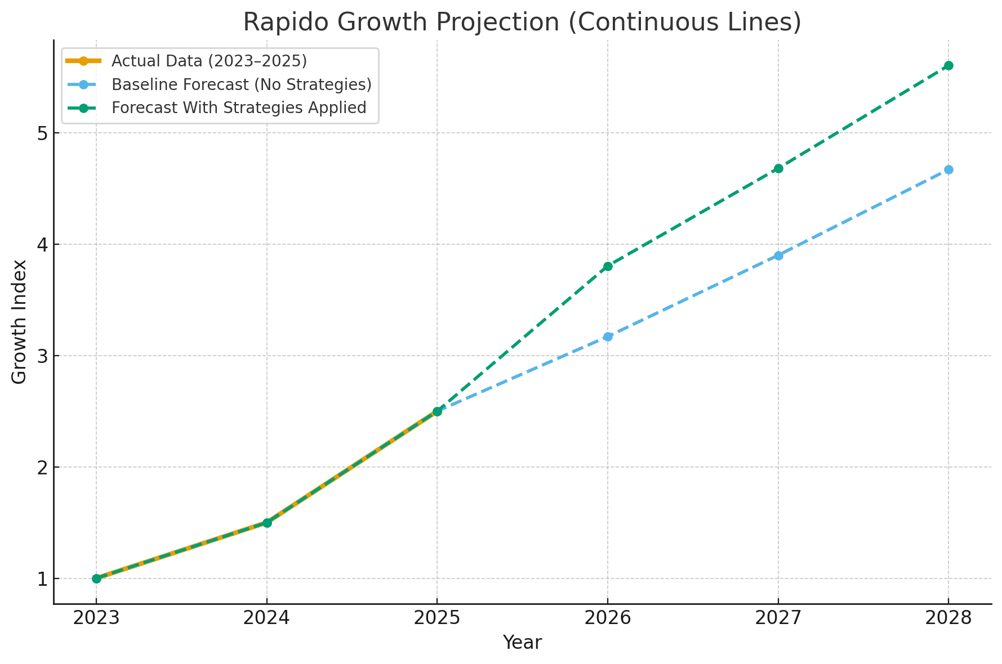
FUTURE PREDICTION BASED ON PAST, PRESENT DATA & INDUSTRIAL BENCH MARKS
Baseline Forecast: Projected using Rapido’s past 3-year growth rate (35–45% YoY) and industry bike-taxi growth (~20–25%). Shows “business-as-usual” trajectory without extra improvements.
Strategy Forecast: Assumes uplift from fixing top customer pain points—privacy, cancellations, safety. supported by industry data (15–30% higher retention & repeat usage).
Notes:
Baseline Forecast: Projected using Rapido’s past 3-year growth rate (35–45% YoY) and industry bike-taxi growth (~20–25%). Shows “business-as-usual” trajectory without extra improvements.
✔ Strategy Forecast: Assumes uplift from fixing top customer pain points—privacy, cancellations, safety—supported by industry data (15–30% higher retention & repeat usage).
✔ Why Growth Increases: Because implementing these strategies aligns Rapido with Ola/Uber’s best practices and closes major trust gaps, driving higher adoption—especially among female riders.

